Slide 1
Agents for Impact – Hackathon: SafePath AI
Powered by NVIDIA AI, Driven by Regulatory Insight
Raghav Rama Bhadran

Slide 2


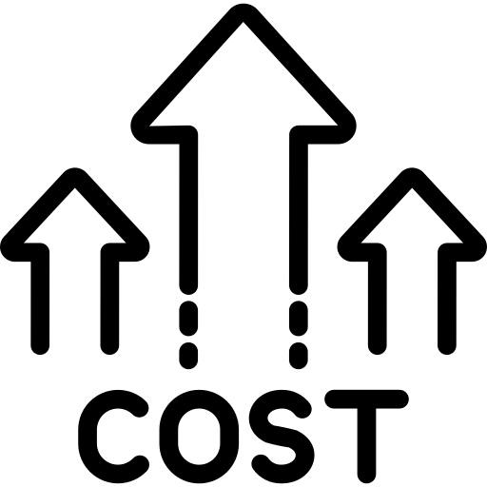
The Hidden Cost of Non-Compliance
300+
FDA CRLs,
Warning letters,
and New Guidances
1000+
Drugs and medical products incidents
(withdrawn or recalled)
$500,000/day in lost sales
~13 months delay
Notes:
[Sources] https://www.raps.org/news-and-articles/news-articles/2013/1/study-shows-impact-of-complete-response-letters-on
https://pubmed.ncbi.nlm.nih.gov/38773058/
https://www.fda.gov/drugs/drug-safety-and-availability/drug-recalls
https://medshadow.org/inside-the-drug-recall-process/
https://www.ecfr.gov/current/title-21/chapter-I/subchapter-A/part-7/subpart-C

Slide 3






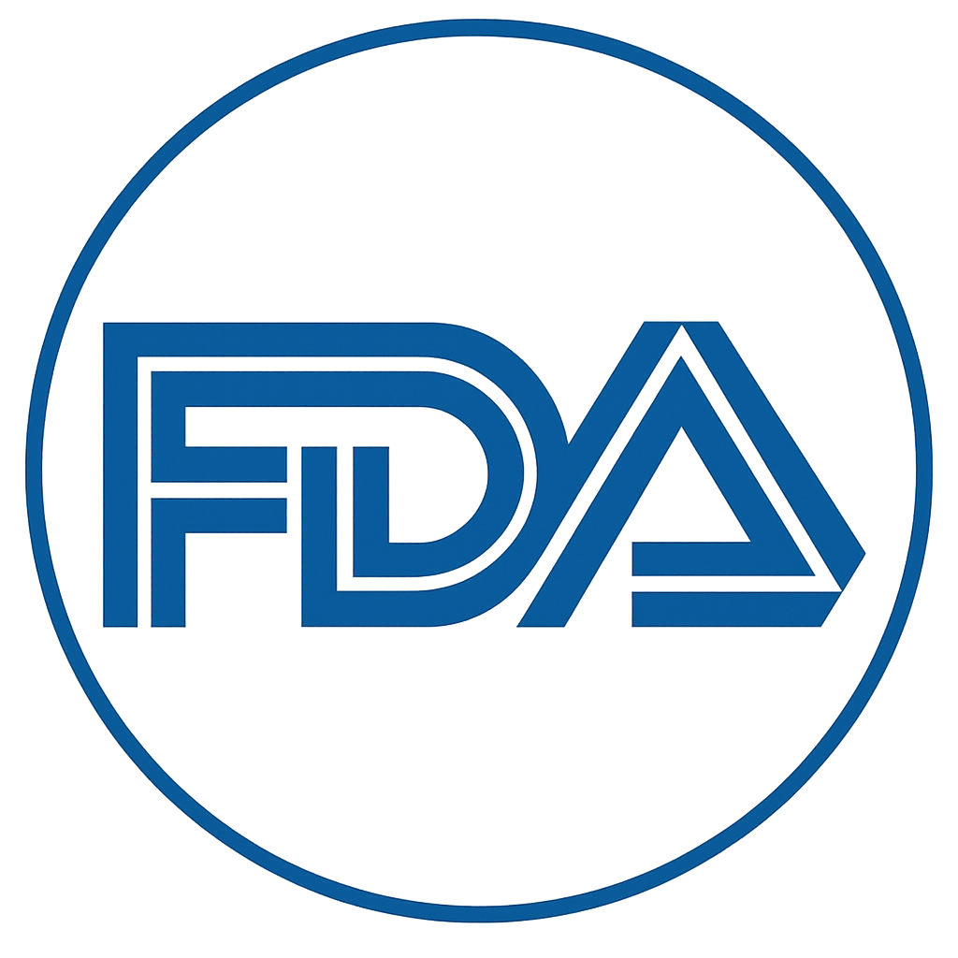
Step 1 — Submit for Review
The regulatory or medical writing team uploads NDA or ANDA submissions, including labelling, reviews, and study data, to SafePath for pre-submission review.
Notes:
SafePath doesn’t just monitor regulations; it reads your submission and flags where you might be non-compliant before you send it to the FDA.

Slide 4
Step 2 — AI-Powered Compliance Review
SafePath, using FDA data, detects frequent problems such as missing safety clauses, dosage mistakes, outdated references, CMC gaps, and incomplete risk management statements.

Slide 5
Step 3 — Submit with Confidence
Now you have a dossier which is compliant and ready for FDA submission.

Slide 6
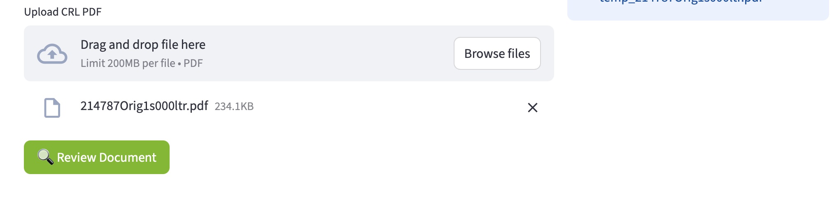
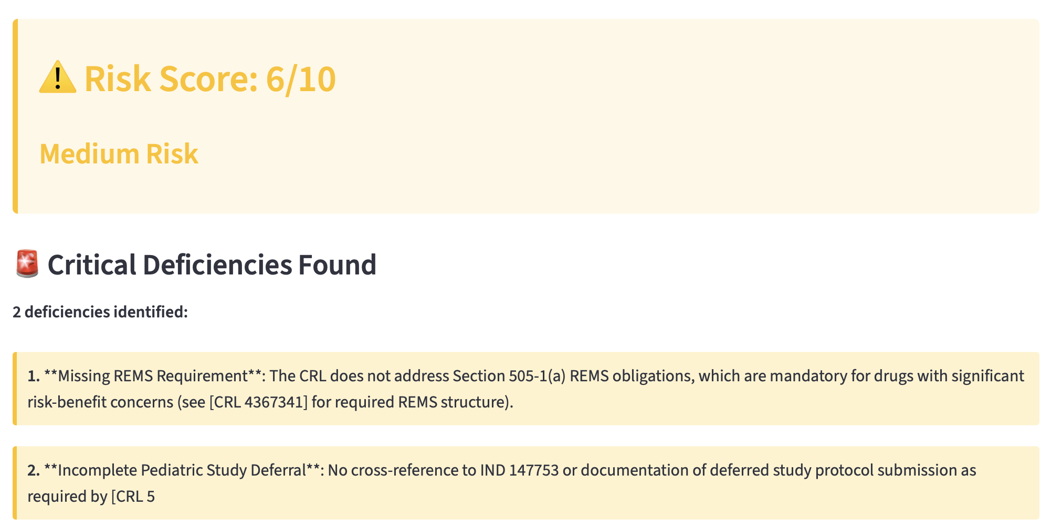
Demo
Notes:
Using

